Slide 1
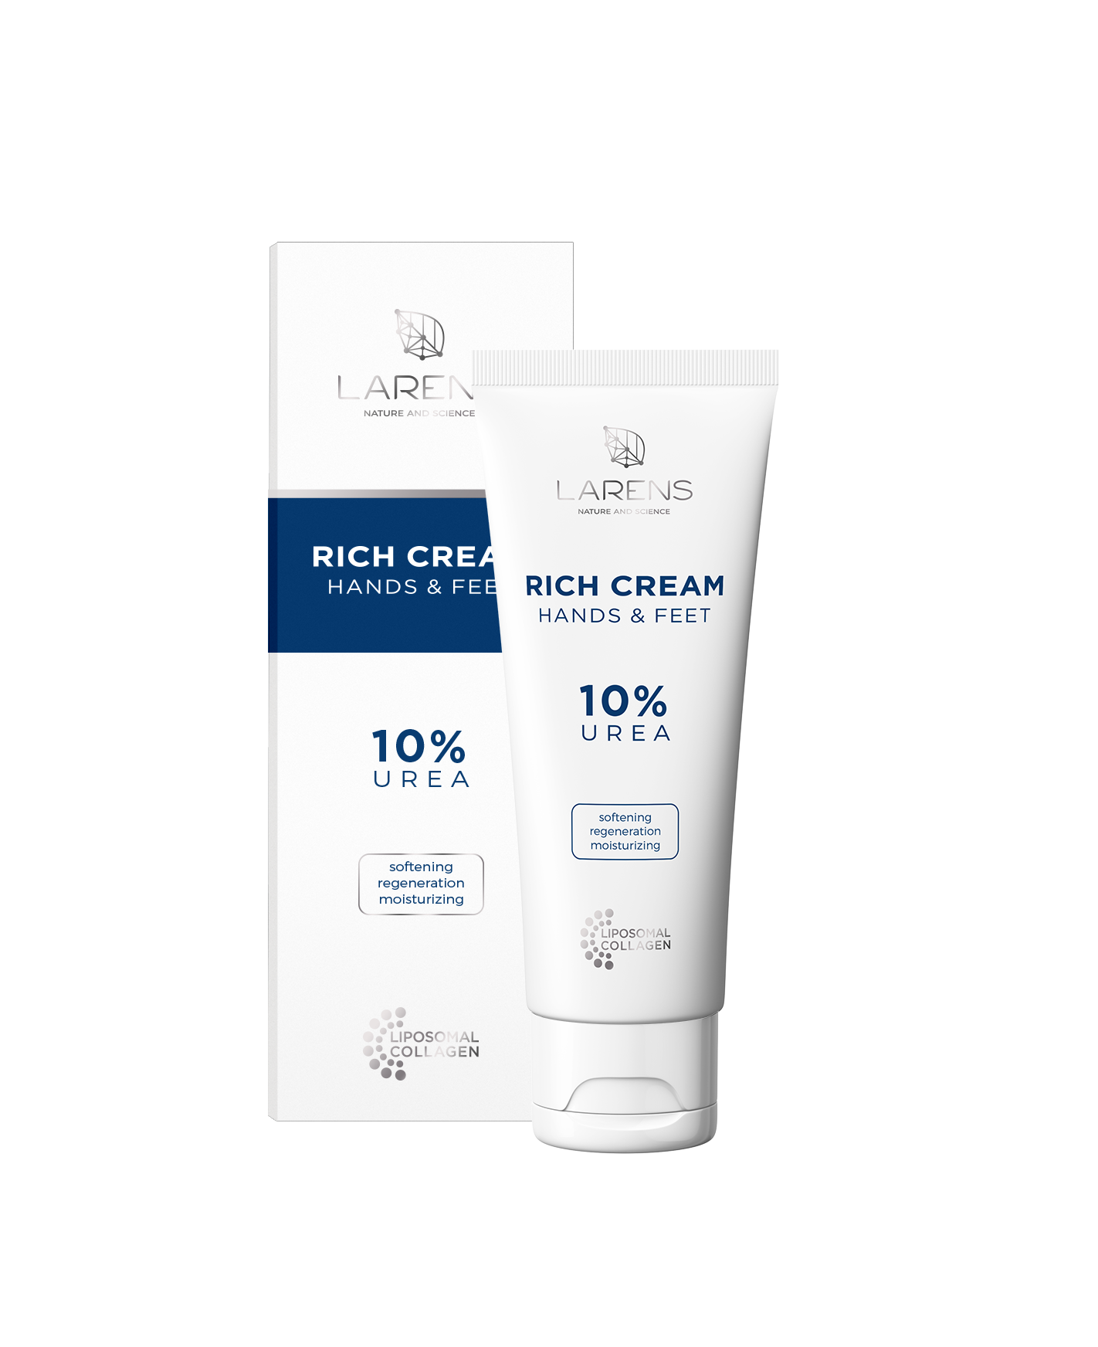

Slide 2
A rich moisturizing-regenerating hand and foot cream with liposome collagen and 10% urea

Slide 3
Rich Cream Hands & Feet formula is rich in selected active components
Urea 10%
Hyaluronic liposomal acid
Liposomal Collagen Complex
Gluconolactone
Zinc gluconate
D-panthenol
Allantoin
Biotin
Vitamin E
Regenerates and gives immediate relief for even very dry, rough and chapped skin

Slide 4
10% concentration urea perfectly moisturizes and softens, however it does not excessively peel the skin
Urea and hyaluronic liposomal acid increase moisture of the skin. They protect the water binding place, thanks to which its content in the stratum corneum is increased
As a result the skin retains the optimum level of moisture; its elasticity and vitality is improved

Slide 5
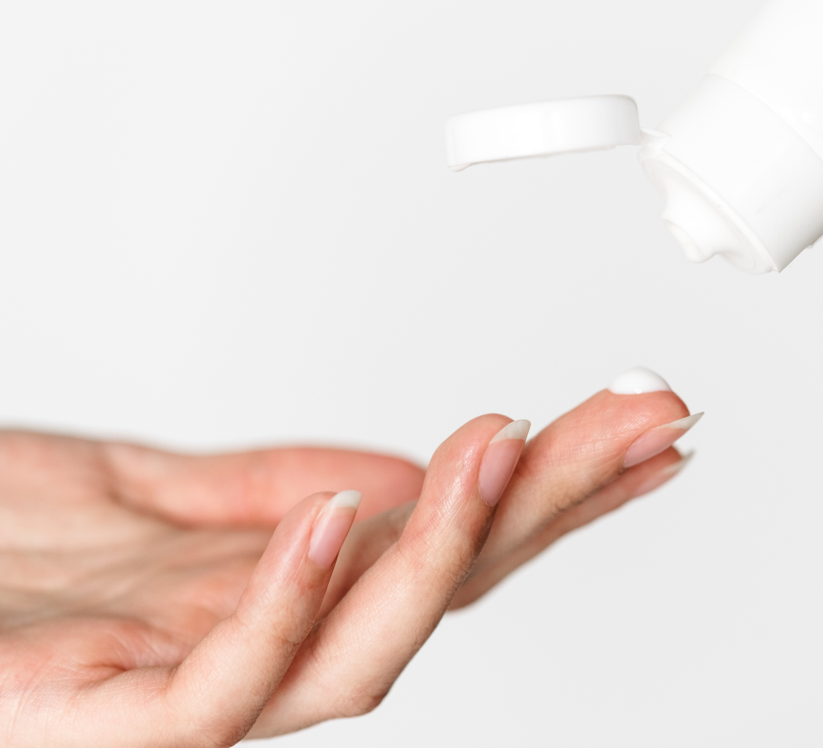
Its unique on the market Liposomal Collagen Complex protects the skin against loss of moisture, saturates it with collagen
improves elasticity, repairs and stimulates regeneration
freepik.com

Slide 6
Gluconolactone, zinc gluconate, D-panthenol and allantoin. It ensures its smoothness and softness
freepik.com
Provide relief for even very dry or irritated skin

Slide 7
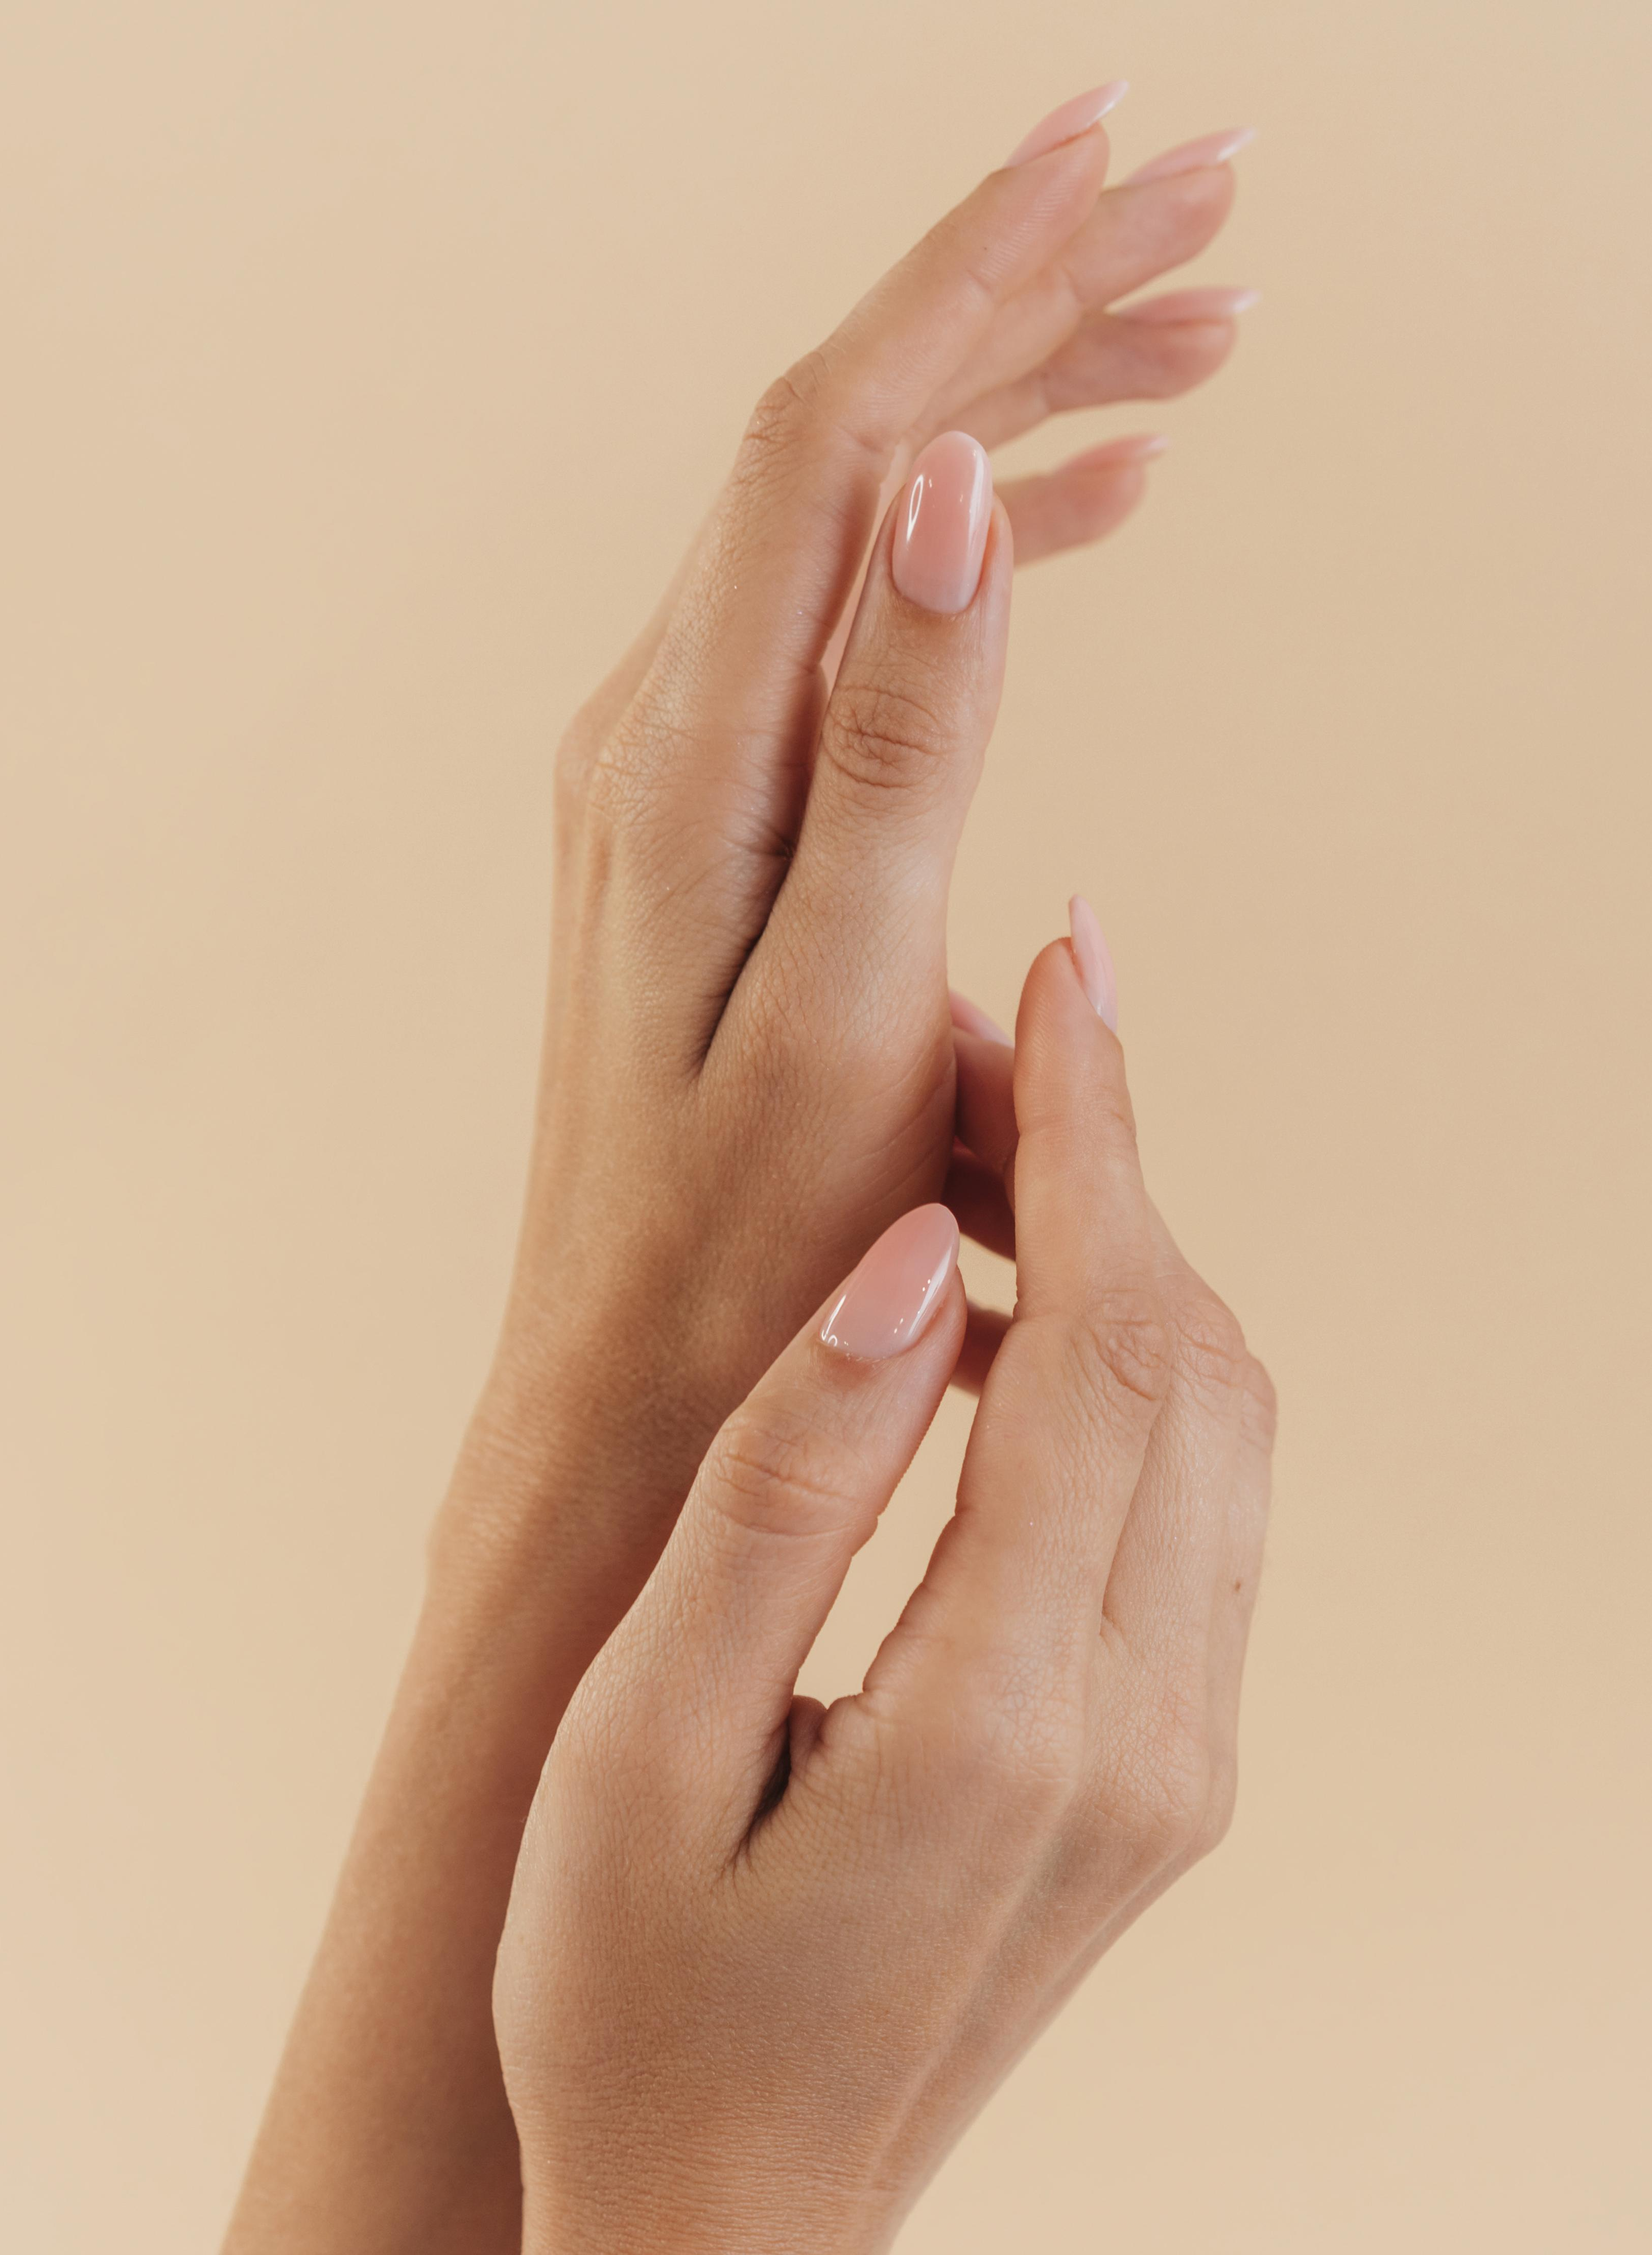
Biotin and Vitamin E stimulate the repair processes and strengthen the skin and nails
freepik.com

Slide 8
How does the Rich Cream works?
it increases moisture of the skin
softens and smoothens the skin
soothes irritation, for example caused by detergents
eliminates itching and feeling of skin tension
accelerates regeneration of the skin
provides relief for dry, rough, chapped skin

Slide 9
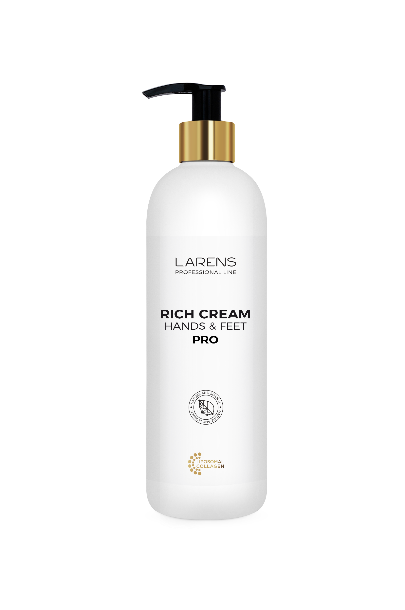
Also available in the Professional Line
57 €
50 £
13 P 400 ml
21,25 €
19 £
5 P 70 ml

